Slide 1




NEXT GEN EMPLOYABILITY PROGRAM
Creating a future-ready workforce
Team Members
College Name
Student Name : S.Sankarammal
Student ID : au951221104042
JP College Of Engineering

Slide 2
Abstract
This abstract outlines the development of a robust online voting platform utilizing the Django framework, designed to facilitate transparent and accessible democratic processes. Leveraging Django's comprehensive features, the application prioritizes security, scalability, and user-friendliness. Key components include secure user authentication, customizable voting methods, real-time result tracking, and stringent security measures to safeguard the integrity of the voting process. The application's intuitive interface and adherence to accessibility standards ensure inclusivity for users of diverse backgrounds and abilities. By harnessing Django's flexibility and extensibility, the platform offers a reliable solution for organizing and conducting various voting events, empowering citizens to participate effectively in shaping their communities and societies.
Source :

Slide 3
Problem Statement
Title: Problem Statement: Developing a Secure and Inclusive Voting Web Application with Django Framework
In today's digital age, traditional voting systems face significant challenges that hinder democratic processes, including accessibility barriers, security vulnerabilities, and transparency concerns. The pressing need for a robust and inclusive voting web application is evident, one that can effectively address these issues while ensuring the integrity and confidentiality of the voting process. Leveraging the Django framework, the objective is to develop a solution that caters to users of diverse backgrounds and abilities, providing a secure platform for transparent and accessible participation in democratic decision-making processes. This problem statement outlines the critical imperatives of building a voting web application that prioritizes security, inclusivity, and transparency, thereby fostering trust and confidence in the electoral process.
Source :

Slide 4
Project Overview
The project aims to develop a comprehensive and secure voting web application using the Django framework, with a focus on enhancing democratic participation and transparency. Leveraging Django's robust features, the application will prioritize user authentication, accessibility, and real-time result tracking to ensure a seamless and trustworthy voting experience. Key components include customizable ballot creation, support for various voting methods, and stringent security measures to safeguard the integrity of the voting process. By providing a user-friendly and inclusive platform, the project seeks to empower citizens to engage actively in democratic decision-making processes while instilling confidence in the fairness and transparency of elections.
Source :

Slide 5
VOTING APPLICATION
.
• Built with a focus on user engagement and security, it ensures a
transparent and accessible voting process for all participants
• This innovative tool is designed to facilitate democratic engagement
and decision-making across diverse groups, fostering a participatory
culture in any setting.
• With Django’s built-in administration interface, you can easily
manage the polls and choices
Source :

Slide 6
Advantages:
Rapid Development: Django follows the "Don't Repeat Yourself" (DRY) principle and provides a wide range of built-in functionalities such as user authentication, admin interface, and ORM, enabling developers to build applications quickly with less boilerplate code.
Scalability: Django's architecture is designed to handle high levels of traffic and scale seamlessly. It offers built-in support for caching, database pooling, and asynchronous task execution, allowing applications to handle large volumes of users and data efficiently.
Community and Documentation: Django has a large and active community of developers who contribute to its development and provide support through forums, mailing lists, and documentation. The official Django documentation is comprehensive and well-maintained, making it easy for developers to learn and troubleshoot issues.
Source :

Slide 7
Disadvantages:
Learning Curve: Django has a steep learning curve, especially for beginners with limited experience in web development or Python programming. Developers may require time to grasp the framework's concepts and conventions.
Opinionated Framework: Django follows the "Django way" of doing things, which can be restrictive for developers who prefer more flexibility and freedom in their frameworks. This could lead to challenges when implementing custom or unconventional features.
Customization Limitations: While Django provides many built-in features, customization beyond its defaults can be challenging and may require diving into the framework's internals. This could pose difficulties when implementing highly specialized or unique requirements.
Performance: While Django is scalable and capable of handling high levels of traffic, it may not be as performant as some other frameworks for certain types of applications. Developers may need to optimize their Django applications for performance, especially when dealing with large datasets or complex business logic.
Source :

Slide 8

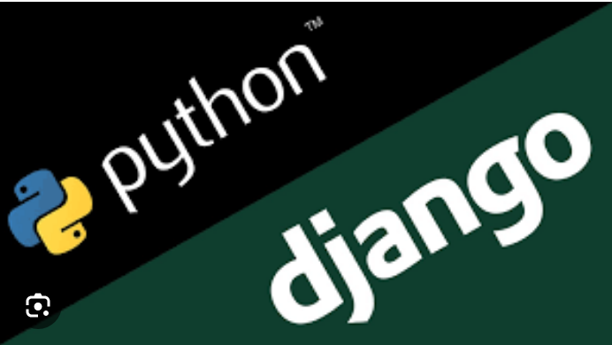


Technology Used
Front-end
Back-end
Source :

Slide 9
Modelling & Results
In the voting web application developed using the Django framework, the data model encompasses entities such as Users, Voting Events, Ballots, Candidates, and Votes. Users register and authenticate securely, gaining access to active voting events where they can cast their votes on customizable ballots featuring various voting methods. Real-time result updates are provided, displaying the current status of the voting process and the accumulated votes for each candidate. The application implements stringent security measures to protect the integrity of the voting process, including encryption techniques and authentication mechanisms. Through Django's built-in admin interface, administrators can manage voting events, candidates, and user accounts efficiently. Overall, the voting web application provides a reliable, user-friendly, and transparent platform for facilitating democratic decision-making processes.
Source :

Slide 10
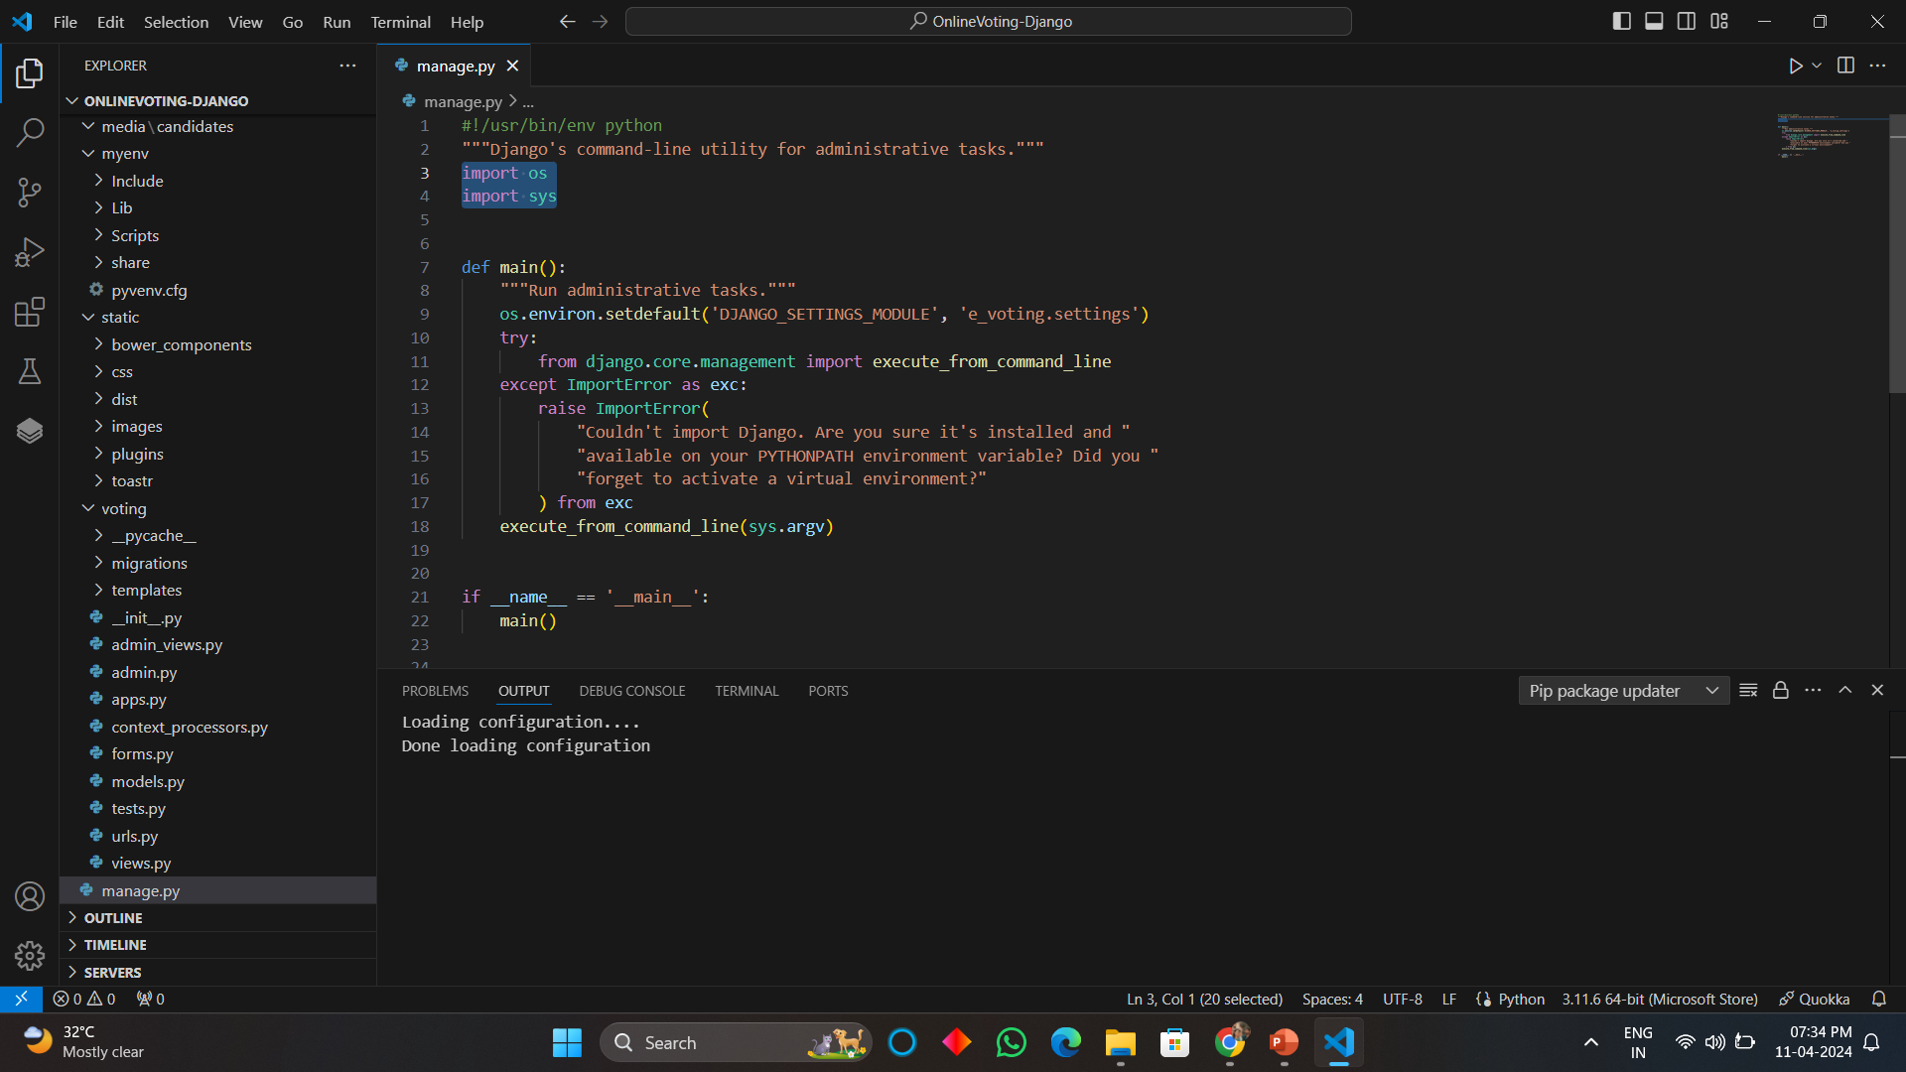
Homepage

Slide 11
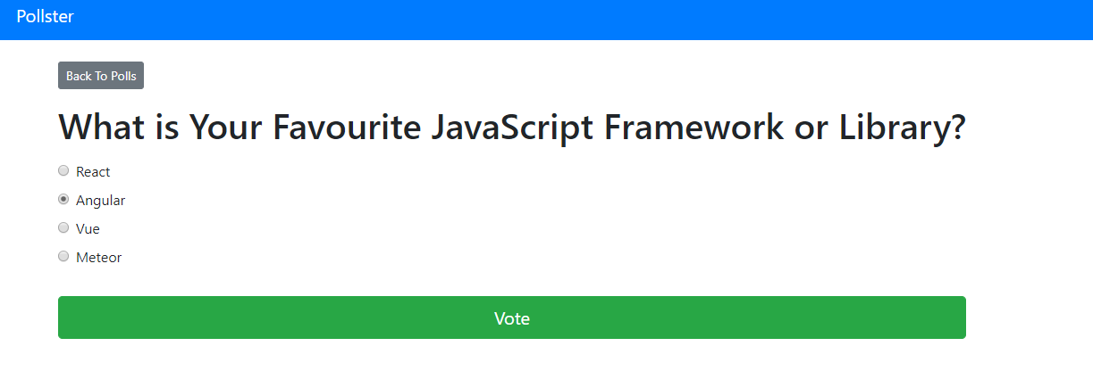
Blog-Page

Slide 12
Conclusion
In conclusion, the voting web application developed using the Django framework represents a significant advancement in facilitating democratic decision-making processes. Through robust security measures, intuitive user interface design, and scalable architecture, the application provides a reliable platform for users to participate in voting events securely and transparently. The utilization of Django's built-in functionalities, coupled with potential future enhancements such as blockchain integration and machine learning algorithms, ensures the continuous evolution and effectiveness of the application in meeting the evolving needs of democratic societies. Overall, the voting web application stands as a testament to the power of technology in fostering inclusive and transparent governance, empowering citizens to actively engage in shaping their communities and societies.
Source :

Slide 13
Thank You!
Notes:
Thank You !!

